Slide 1
Sociology: 3459 Central tendency variability and dispersion
Recitation #3
Yue Chu

Slide 2
announcement
Homework #1 is due Sep.25.
Demonstrate the formula and steps of calculation clearly.
Make sure to submit your homework pdf via Carmen on time.

Slide 3
agenda
Review of lecture
Activity
Descriptive statistics
Central tendency
Variability and dispersion
In class exercise
Stata output
Q&A for homework#1

Slide 4
Descriptive statistics
Describe the basic features of the data in a study.
Descriptive statistics | Inferential statistics
Simple summaries about the sample and the measure. Describing what the data shows. | Trying to reach conclusions that extend beyond the immediate data alone. Infer from the sample data to more general population

Slide 5
RECALL LAST week
Levels of measurement | Nominal | Ordinal | Interval | Ratio
Features | Categories with no order | Ordered categories | Meaningful differences between values, no true zero | Knowing the order, exact value between units, AND have a true zero
Example | Race | Social class | Temperature | Income
Frequency distributions | Yes | Yes | Yes | Yes
This week
Two more ways to summarize interval/ratio data:
Central tendency; Variation

Slide 6
Central Tendency
Values that defines most typical outcomes of distribution
Mode: the value of category or interval which occurs most frequently
How to find: the value with highest frequency
Note: Data can have no, one, or more than one mode
Median: the value or category that divides ordered distribution in half
How to find: order data, then find the middle value
Note: equivalent to 50th percentile
Mean: arithmetic average
How to find: sum of values of all observations / number of cases
Note: mean is affected by values of every case
Notes:
Mode:
The category or value that occurs most frequently
Useful for variables at ANY level of measurement
The mode is the largest category, not necessarily the majority
Median
The category or value that divides an ordered distribution in half
Useful for ordinal or interval level variables
Half of the cases will be at or above the median value
Half of the cases will be at or below
Mean
The sum of all values of all the observations divided by the number of observations
The mathematical/arithmetic average
The most powerful measure of central tendency—it takes into account the value of every single case
Question
Is mean always the ”best” measure?
Why might the median be a better measure of central tendency for some data?

Slide 7
example
Score of a quiz for 12 students, calculate mode
Score
4
5
0
1
2
3
5
4
4
1
3
4
Mode
1. Get frequencies
2. Find the value / category with highest frequencies.
Median
1. Order data
2. Even or odd total observations
3. Find the middle value if odd, find average of middle two values if even.
Median = (3+4)/2 = 3.5
Score | Order
0 | 1
1 | 2
1 | 3
2 | 4
3 | 5
3 | 6
4 | 7
4 | 8
4 | 9
4 | 10
5 | 11
5 | 12
Score | Frequency
0 | 1
1 | 2
2 | 1
3 | 2
4 | 4
5 | 2
Total | 12

Slide 8
example
Score of a quiz for 12 students, calculate mode, median and mean.
Score
4
5
0
1
2
3
5
4
4
1
3
4
Mean
Method 1: sum of values from all observations, divided by total number of observations
Method 2: sum of (category value * frequency for that category), divided by total number of observations
$$\overline{X}=\frac{Σ\left(X_{i}\right)}{N}=\frac{(4+5+0+1+2+3+5+4+4+1+3+4)}{12}=3$$
Score | Frequency
0 | 1
1 | 2
2 | 1
3 | 2
4 | 4
5 | 2
$$\overline{X}=\frac{Σ\left(x∗f\right)}{N}=\frac{0∗1+1∗2+2∗1+3∗2+4∗4+5∗2}{12}=3$$

Slide 9
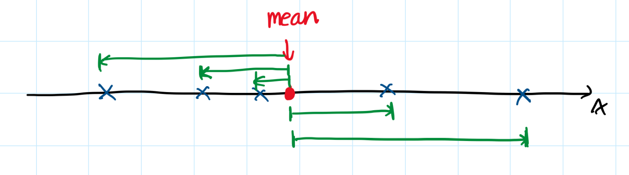


characteristics of the mean
Mean “balances out” all scores in the distribution
Least squares principle: mean minimizes variation of the scores.
$$Σ(X_{i}−\overline{X})=0$$
$$Σ{\left(X_{i}−\overline{X}\right)}^{2}=minimum$$

Slide 10
Comparing measures of Central tendency
Descriptive statistics | Nominal | Ordinal | Interval | Ratio | Advantage | Disadvantage
Mode | Yes | Yes | Yes | Yes | Available for all levels of measurements | Only used limited information from the variable
Median | No | Yes | Yes | Yes | Not affected by small number of extreme cases | Only used limited information from the variable
Mean | No | No | Yes | Yes | Most stability in random samples; Uses all available information from the variable | Affected by extreme values (outliers)

Slide 11
Skewness, mean and median
Skewness: lack of symmetry in distribution
Describes the shape of a distribution

Slide 12
Dispersion and variability
Dispersion:
The variety, diversity or amount of variation among scores
Variability:
The spread or dispersion of set of scores around central value
Measurements:
Range
Variance
Standard deviation
Notes:
Variability describes the spread or dispersion of set of scores around central value

Slide 13
range
Difference between the largest & smallest scores in a distribution
Example: quiz score example
Range: 5-0=5
Question: Group B scores have the same range as group A, does it mean the two groups have same level of variation?
Determined by extreme values.
Lack of information between extremes.
Group A | Group B
4 | 4
5 | 3
0 | 4
1 | 5
2 | 5
3 | 5
5 | 4
4 | 4
4 | 4
1 | 3
3 | 3
4 | 0

Slide 14
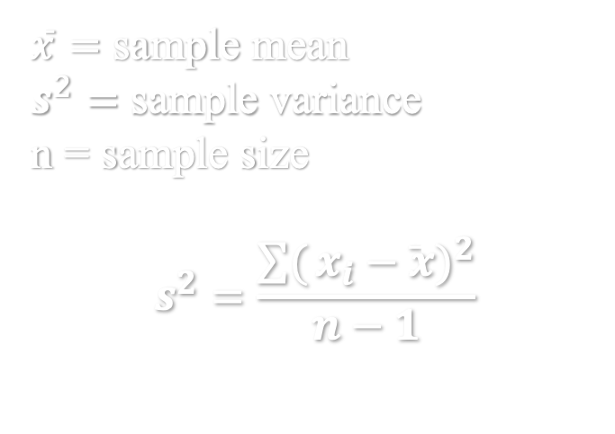
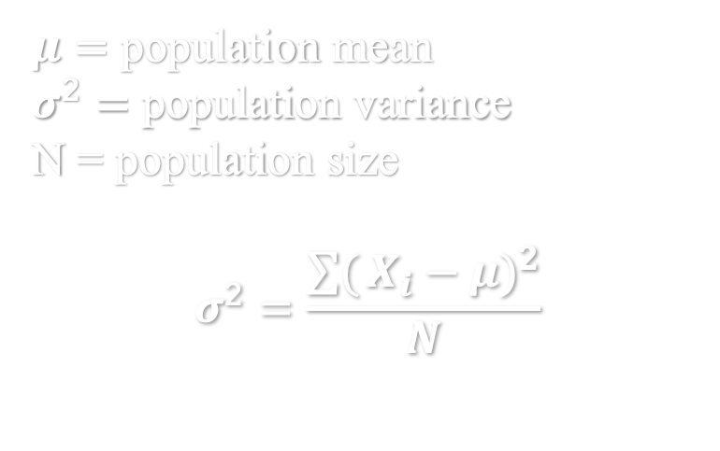
variance
Average of squared deviations from the mean
Deviation: difference between each and every score & mean (with +/- signs)
Smaller variance indicates more scores are similar to one another.
$μ=$ population mean
$σ^{2}=$ population variance
N = population size
$$σ^{2}=\frac{\sum{(}{X_{i}−μ)}^{2}}{N}$$
$\overline{x}=$ sample mean
$s^{2}=$ sample variance
n = sample size
$$s^{2}=\frac{\sum{(}{x_{i}−\overline{x})}^{2}}{n−1}$$
Correct potential underestimation of variability especially for samples with small sample size

Slide 15
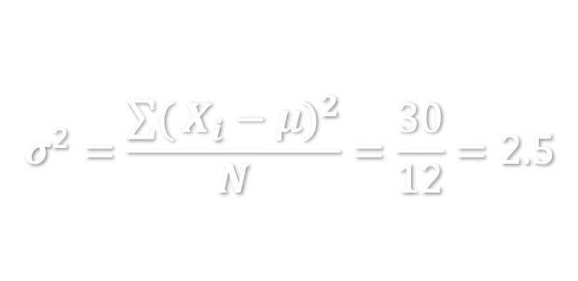
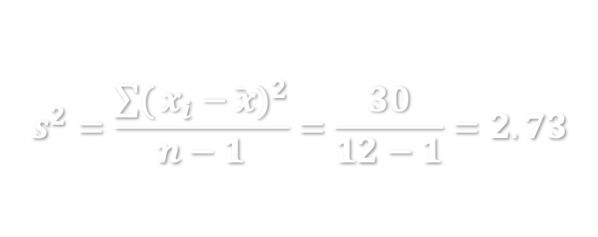
example
Calculate variance of score
Treat group A as a population
The average of the squared distances from each quiz score to the mean for this population is 2.5.
Treat group A as a sample
The average of the squared distances from each quiz score to the mean for this sample is 2.73.
Score | Squared Dev.
4 | (4-3) ² = 1
5 | (5-3) ² = 4
0 | (0-3) ² = 9
1 | (1-3) ² = 4
2 | (2-3) ² = 1
3 | (3-3) ² = 0
5 | (5-3) ² = 4
4 | (4-3) ² = 1
4 | (4-3) ² = 1
1 | (1-3) ² = 4
3 | (3-3) ² = 0
4 | (4-3) ² = 1
Mean = 3 | Sum = 30
$$σ^{2}=\frac{\sum{(}{X_{i}−μ)}^{2}}{N}=\frac{30}{12}=2.5$$
$$s^{2}=\frac{\sum{(}{x_{i}−\overline{x})}^{2}}{n−1}=\frac{30}{12−1}=2.73$$
Notes:
the average of the squared distances from each point to the mean.

Slide 16
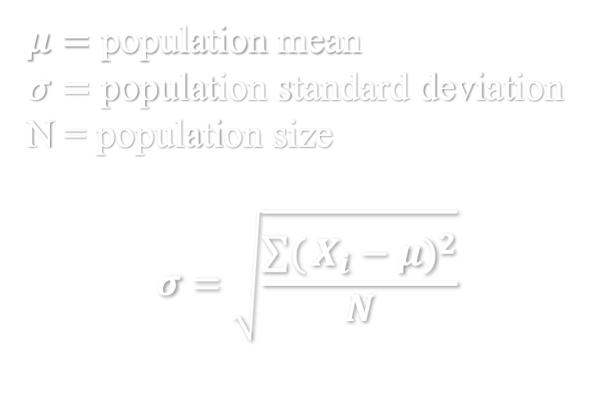
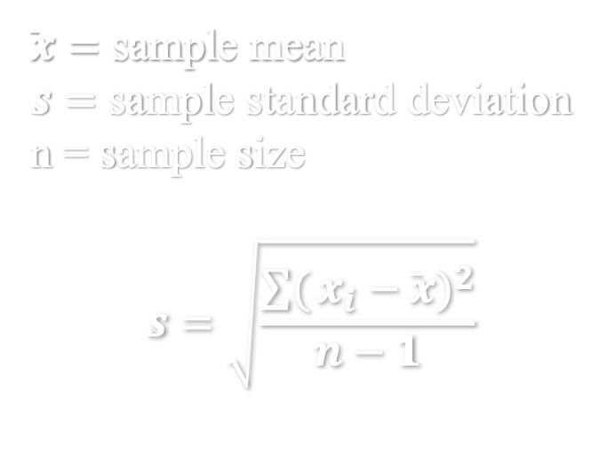
standard deviation (SD)
Standard deviation is the square root of variance.
Easier to interpret: On average, how far away the scores in distribution are from the mean
$μ=$ population mean
$σ=$ population standard deviation
N = population size
$$σ=\sqrt{\frac{\sum{(}{X_{i}−μ)}^{2}}{N}}$$
$\overline{x}=$ sample mean
$s=$ sample standard deviation
n = sample size
$$s=\sqrt{\frac{\sum{(}{x_{i}−\overline{x})}^{2}}{n−1}}$$
Notes:
Convert the variance back to original metric

Slide 17
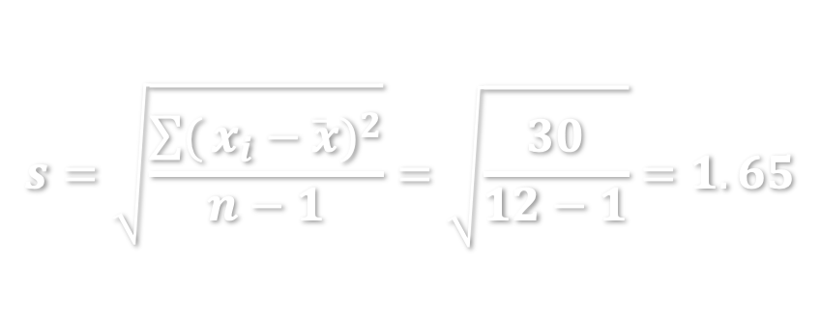
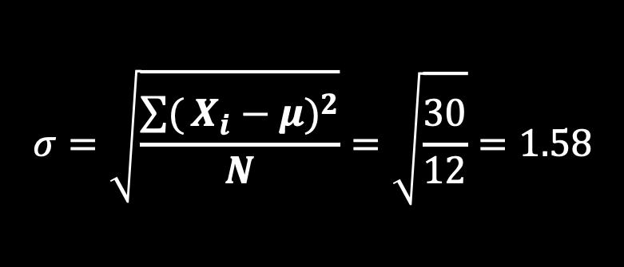
example
Calculate the standard deviation of score
$$σ=\sqrt{\frac{\sum{(}{X_{i}−μ)}^{2}}{N}}=\sqrt{\frac{30}{12}}=1.58$$
Treat group A as a population
On average, the quiz score for this population differs from the mean score by 1.58 point.
Treat group A as a sample
On average, the quiz score for this sample differs from the mean score by 1.65 point.
$$s=\sqrt{\frac{\sum{(}{x_{i}−\overline{x})}^{2}}{n−1}}=\sqrt{\frac{30}{12−1}}=1.65$$

Slide 18
kurtosis
How spread out (heavy-tailed) or compact (light-tailed) is a distribution
Describes the shape of a distribution

Slide 19

Coefficient of relative variation
A measure constructed so we can compare variations between two groups with different means
$$CRV= \frac{s}{\overline{x}}$$
Example: 2 group quiz score
Interpretation: Relative to the mean, there was more variation in quiz score in group A than in group B.
 | Group A | Group B
Sample SD | 1.65 | 1.24
Sample mean | 3.00 | 3.58
CRV | 0.55 | 0.35
Notes:
Calculated as sample standard deviation divided by sample mean

Slide 20
Comparing measures of dispersion
Descriptive statistics | Nominal | Ordinal | Interval | Ratio | Advantage | Disadvantage
Range | No | Yes | Yes | Yes | Simplest measure; Applicable to ordinal data | Determined by extreme values; lack of information between extremes
Variance | No | No | Yes | Yes | Taking into account distance of every value from mean | Harder to interpret
Standard Deviation | No | No | Yes | Yes | Taking into account distance of every value from mean; Easier to interpret | Takes effort to calculate

Slide 21
Hand calculation can be tedious. Stata can do this in less than 1 second!

